Slide 1
DATA WAREHOUSING AND BUSINESS INTELLIGENCE – MIDTERM PROJECT (SPRING 2018)
Team Members: Guided By:
AAYUSHI Sachdeva Richard Sherman
Karan Bhavsar
Radhika Maheshwari
Sandhiya Ramesh

Slide 2
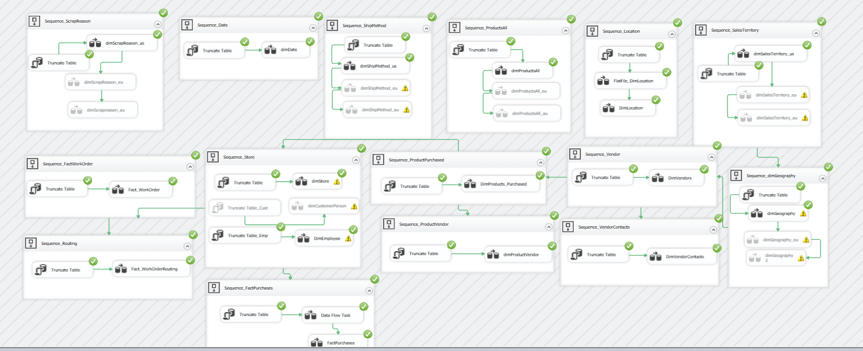
SSIS CONTROL FLOW

Slide 3
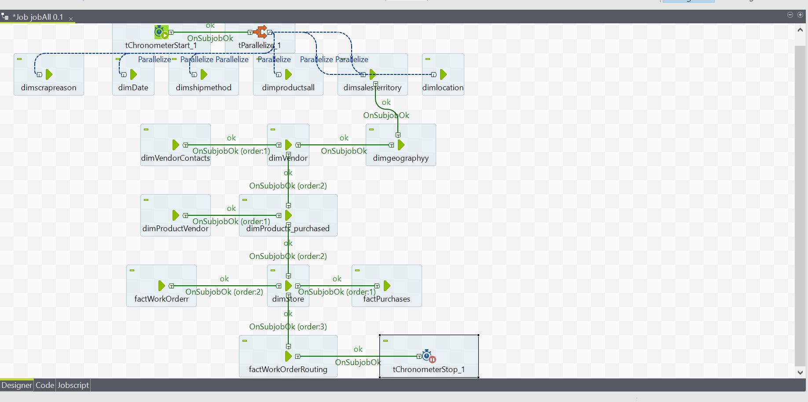
Talend CONTROL FLOW

Slide 4
DimDate | 3652 rows
DimEmployee | 284 rows
DimGeography | 402 rows
DimLocation | 14 rows
DimProducts_Purchased | 265 rows
DimProductsAll | 504 rows
DimProductVendor | 460 rows
DimSalesTerritory | 5 rows
DimScrapReason | 16 rows
DimShipMethod | 5 rows
DimStore | 427 rows
DimVendorContacts | 156 rows
DimVendors | 104 rows
Fact_WorkOrder | 71856 rows
Fact_WorkOrder_Rejects | 735 rows
Fact_WorkOrderRouting | 66748 rows
Fact_WorkOrderRouting_Rejects | 383 rows
FactPurchases | 9578 rows
FactPurchases_Rejects | 152 rows
Outputs Rows

